Slide 1
Midterm + HW/Lab 6
Lab 6 is out now
HW6 is out later today.
They cover midterm content and are practice for the midterm.
However, due to the MT, there will be no new labs next week, so you will have two weeks do finish if you need.

Slide 2
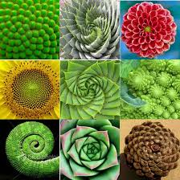
Tree Recursion

Slide 3
Learning Objectives
Write Recursive functions with multiple recursive calls
Understand Recursive Fibonacci
Understand the the count_change algorithm
Bonus: Use multiple recursive calls in to sort a list.

Slide 4
Tree Recursion
Tree Recursion in which involves multiple recursive calls to solve a problem.
Drawing out a function usually looks like an “inverted” tree.
Revisit the "vee" program from lecture 11.
Many of these programs can't be written with iteration very easily
You can solve any problem with recursion or iteration, but this technique that makes some problems simpler.

Slide 5
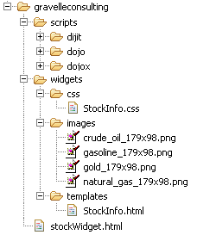
Example I
List all items on your hard disk
Files
Folders contain
Files
Folders
def process_directory(directory):
for item in directory:
if is_file(item):
process_file(item)
else:
process_directory(item)

Slide 6
The Fibonacci Sequence

Slide 7
The Fibonacci Sequence
0, 1, 1, 2, 3, 5, 8, 13, 21, 34, 55, 89…
F0 = 0, F1 = 1
Fn = F(n-1) + F(n-2)

Slide 8
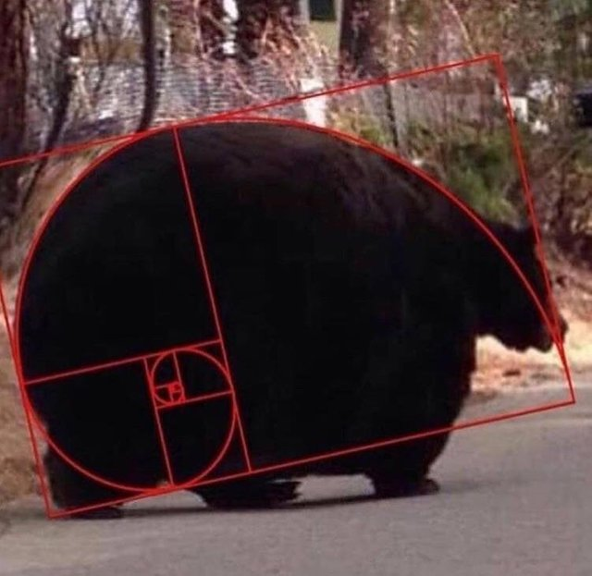
Golden Spirals Occur in Nature
GO BEARS

Slide 9
Fibonacci Code
fibonacci(n) = fibonacci(n-1) + fibonacci(n-2)
where fibonacci(1) == 1 and fibonacci(0) == 0
def fib(n):
"""
>>> fib(5)
5
"""
if n < 2:
return n
return fib(n - 1) + fib(n - 2)

Slide 10
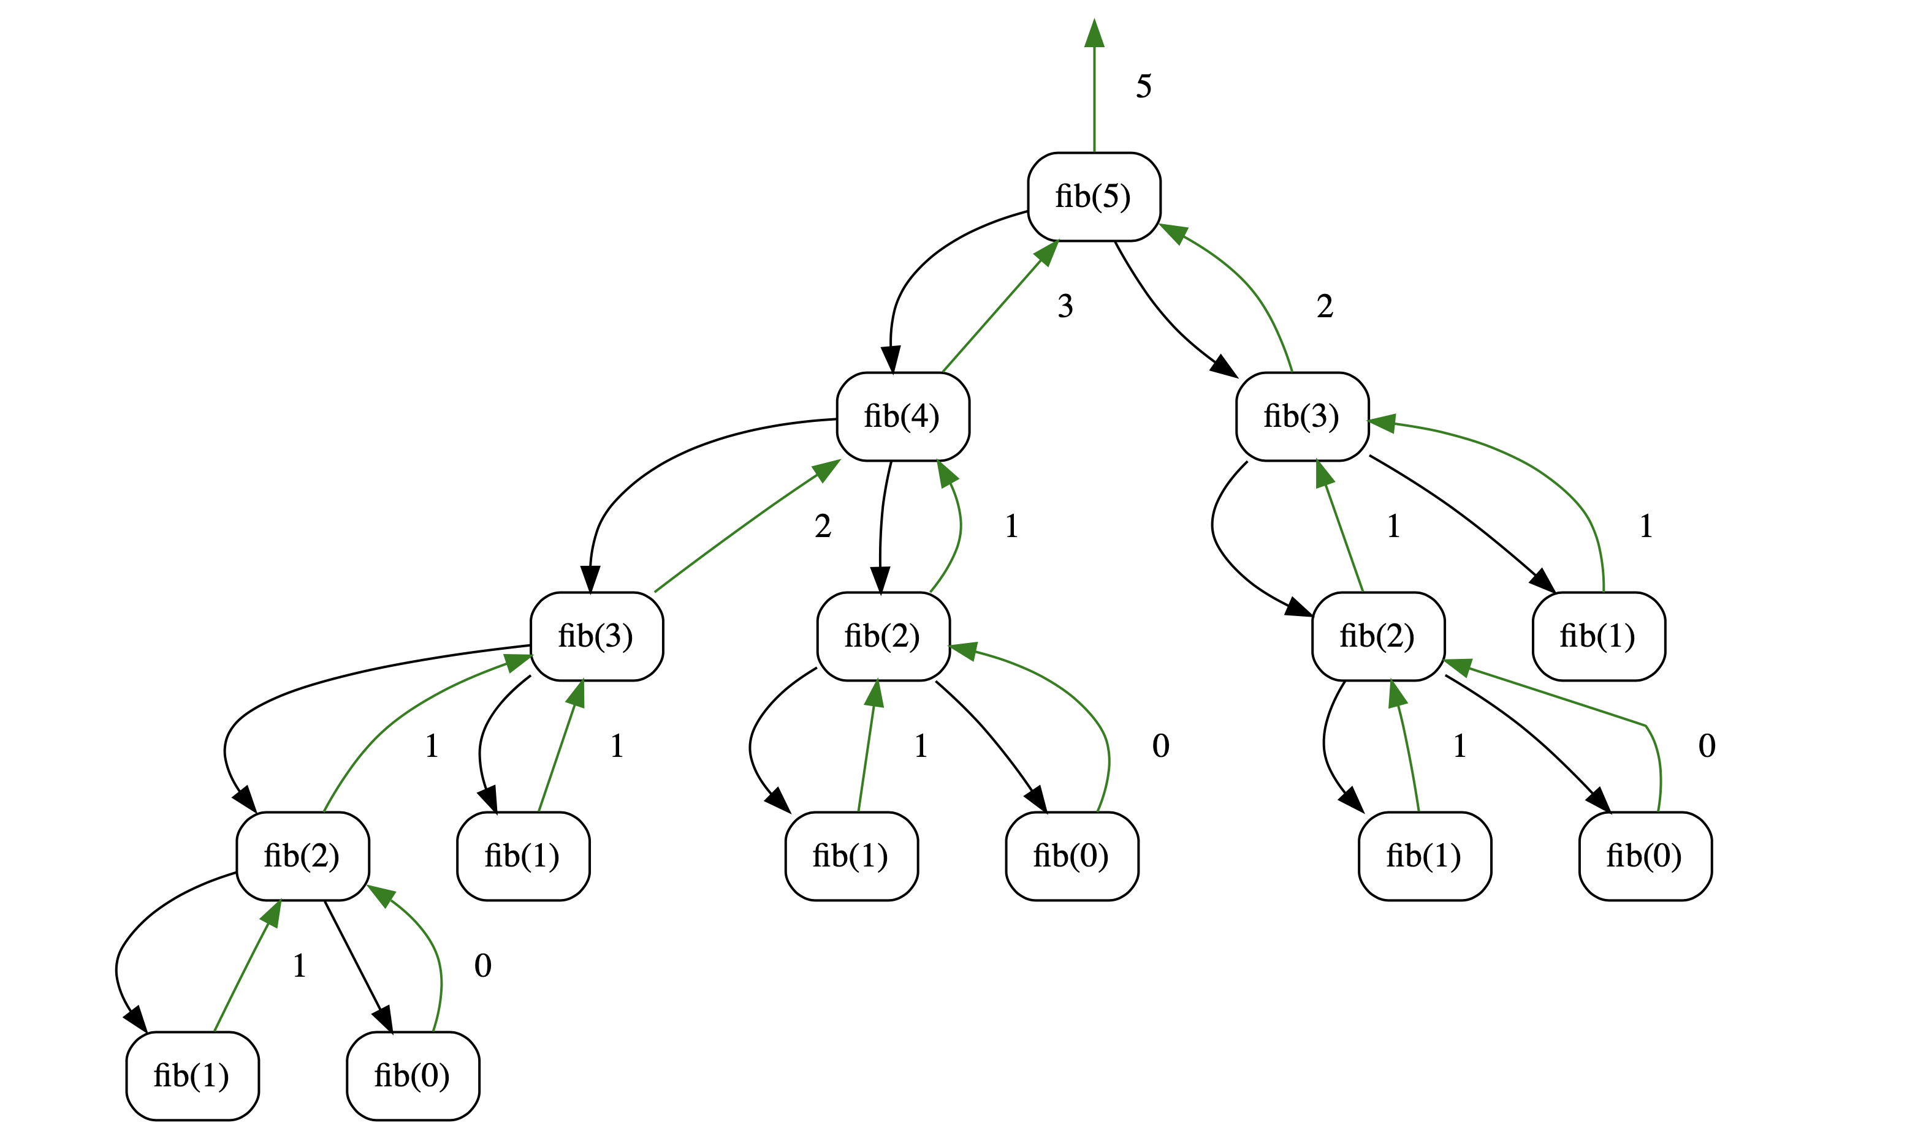
Visualizing Fib Recursion:
Interactive View

Slide 11
But what about the iterative version?
In practice, recursive fib is slow!
We can write the program using a for loop.
How do we translate this? You've done it before!
Technique is called "dynamic programming".
def iter_fib(n):
(n_1, n_2) = (0, 1)
for i in range(0, n):
# This computes n_1+n_2 before updating n_1
(n_1, n_2) = (n_2, n_1 + n_2)
return n_1

Slide 12
What's Similar to Fibonacci?
Many number sequences have similar properties
Catalan numbers
Pascal's Triangle
"Branching" Patterns in Biology:
(Real) Tree branches
Veins in leaves
Romanesco Broccoli
Population growth of animals over N generations
Some of these structures can be modeled recursively

Slide 13
Count Change

Slide 14
Counting Change
Problem Statement:
Given (an infinite number of) coins, (25¢, 10¢, etc) how many different ways can I represent 10¢?
e.g. 5¢ can be made 2 ways: 1 nickel, or 5 pennies
10¢ can be made 4 ways: [1x 10¢, 2x 5¢, 1 5¢ + 5 1¢, 10x 1¢]
Order doesn't matter, 5¢ + 5 1¢ is the same as 5 1¢ + 5¢
How do we solve this?

Slide 15
Why use problems like count change?
We're partitioning coins, but these could be bills, or other currency
Explore of problem like count_partitions
Many tree recursive questions follow a similar recursive step
Notice how instead of a conditional, we combine the results of two possible options
We make recursive calls for all possible outcomes, then the base case(s) handle the conditional logic.

Slide 16
Counting Change
Problem Statement:
Given (an infinite number of) coins, (25¢, 10¢, etc) how many different ways can I represent 10¢?
e.g. 5¢ can be made 2 ways: 1 nickel, or 5 pennies
10¢ can be made 4 ways: [1x 10¢, 2x 5¢, 1 5¢ + 5 1¢, 10x 1¢]
Order doesn't matter, 5¢ + 5 1¢ is the same as 5 1¢ + 5¢
How do we solve this?

Slide 17
Counting Change
change for 25¢ using [25, 10, 5] → 4
What do we return?
1 if valid count
0 otherwise
What are possible “smaller” problems?
Smaller amount of money → use coin
Fewer coins → “discard” coin
What is our base case?
valid count: value is 0
invalid count: value is < 0, or no coins left
Recursion:
Divide: split into two problems (smaller amount & fewer coins)
Combine: addition (# of ways)

Slide 18
count_change code
def count_change(value, coins):
"""
>>> denominations = [50, 25, 10, 5, 1]
>>> count_change(7, denominations)
2
"""
if value < 0 or len(coins) == 0:
return 0
elif value == 0:
return 1
using_coin = count_change(value - coins[0], coins)
not_using_coin = count_change(value, coins[1:])
return using_coin + not_using_coin

Slide 19
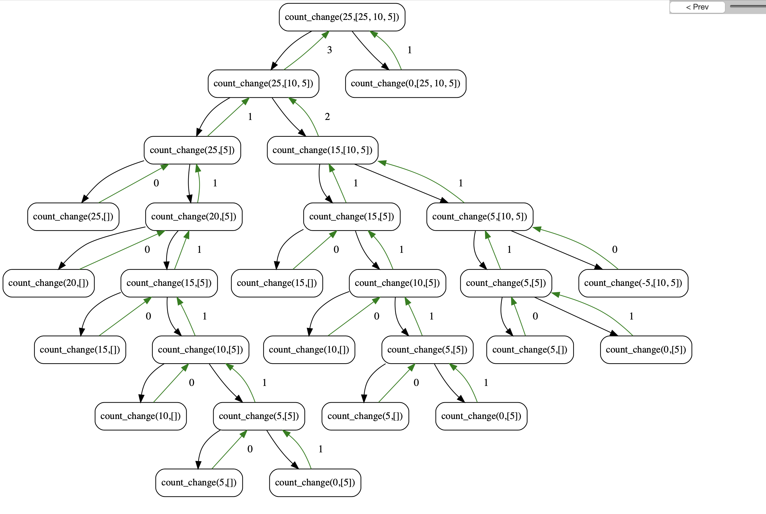
Visualizing Count Change
Interactive view

Slide 20
Why use problems like count change?
We're partitioning coins, but these could be bills, or other currency
Explore of problem like count_partitions
Many tree recursive questions follow a similar recursive step
Notice how instead of a conditional, we combine the results of two possible options
We make recursive calls for all possible outcomes, then the base case(s) handle the conditional logic.

Slide 21
There are many more recursive problems!
The Knapsack Problem: Maximize the value of items thrown in a bag up to some "weight"
Anything relating to Family Trees, Relationships, Social Networks
Count the Nth degree of "followers of followers" of some one
Many of these involve graphs which you'll learn in CS61B
Subsets, Combinations, Permutations
Longest Common Subsequence of 2 sets
Imagine 2 words, or 2 strings of DNA

Slide 22
Bonus: Quicksort

Slide 23
Quicksort
A fairly simple to sorting algorithm
Goal: Sort the list by breaking it into partially sorted parts
Pick a “pivot”, a starting item to split the list
Remove the pivot from your list
Split the list into 2 parts, a smaller part and a bigger part
Then recursively sort the smaller and bigger parts
Combine everything together: the smaller list, the pivot, then the bigger list

Slide 24
QuickSort Example
[3, 3, 1, 4, 5, 4, 3, 2, 1, 17]
[3, 1, 3, 2, 1]
[4, 5, 4, 17]
[1, 3, 2, 1]
[]
[4]
[5, 17]
[1]
[3, 2]
[]
[]
[]
[17]
[]
[]
[2]
[]
[4]
[]
[]
[1]
[]
[]
[5, 17]
[2, 3]
[4, 4, 5, 17]
[1, 1, 2, 3]
[1, 1, 2, 3, 3]
[1, 1, 2, 3, 3, 3, 4, 4, 5, 17]

Slide 25
Tree Recursion
Break the problem into multiple smaller sub-problems, and Solve them recursively
def split(x, s):
return [i for i in s if i <= x], [i for i in s if i > x]
def quicksort(s):
"""Sort a sequence - split it by the first element,
sort both parts and put them back together."""
if not s:
return []
else:
pivot = s[0]
smaller, bigger = split(pivot, s[1:])
return quicksort(smaller) + [pivot] + quicksort(bigger)
>>> quicksort([3,3,1,4,5,4,3,2,1,17])
[1, 1, 2, 3, 3, 3, 4, 4, 5, 17]

Slide 26
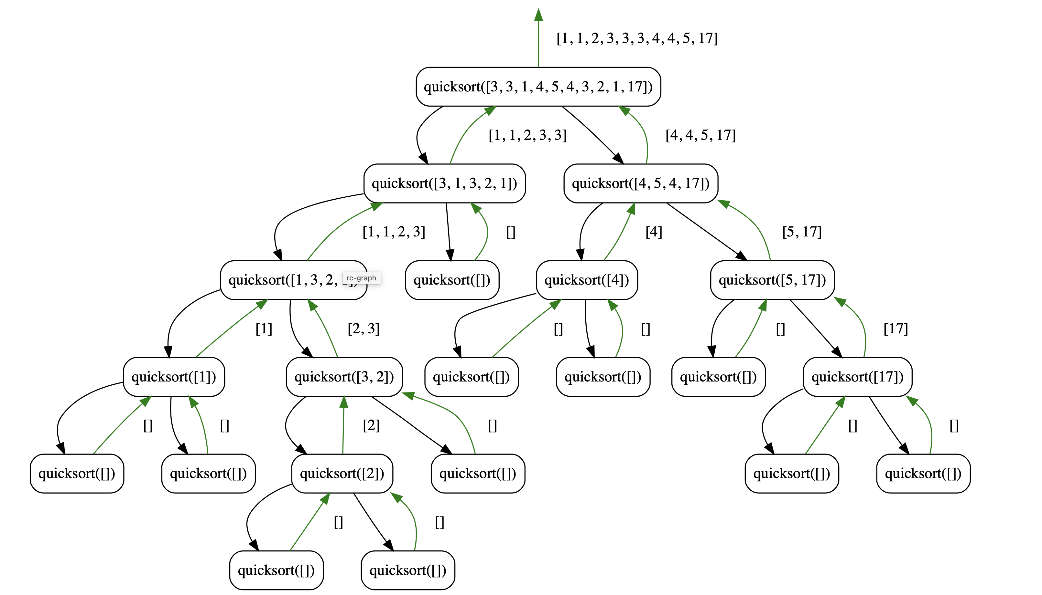
Quicksort Visualization
Interactive View

